Slide 1

Bootstrap
PPT by - Shafeeq Khan

Slide 2

| What is Bootstrap |
Bootstrap is a free and open-source CSS framework directed at responsive, mobile-first front-end web development. It contains HTML, CSS and JavaScript-based design templates for typography, forms, buttons, navigation, and other interface components.

Slide 3
| How to Use |
A basic understanding of HTML is required to start learning Bootstrap. Some familiarity with how CSS works (CSS Selectors and Visual Rules) would be helpful,
Download Bootstrap from getbootstrap.com
Include Bootstrap from a CDN

Slide 4
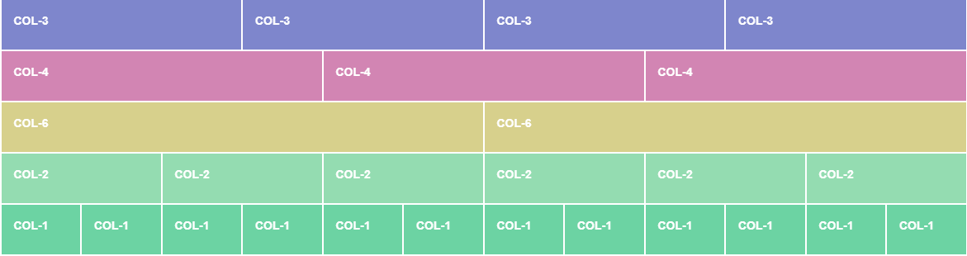

| Bootstrap Grid |
The Bootstrap grid system has four classes: xs (<576px wide) sm ( >576px wide) md (for >768px wide) lg ( >992px wide) xl ( >1200px wide) XXl (For >1400px wide)

Slide 5
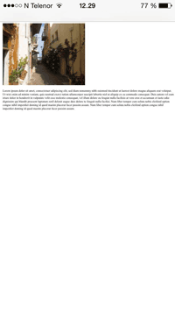
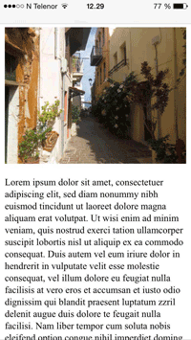
| Viewport |
The viewport is the user's visible area of a web page.
The viewport varies with the device, and will be smaller on a mobile phone than on a computer screen.
<meta name="viewport" content="width=device-width, initial-scale=1.0">

Slide 6
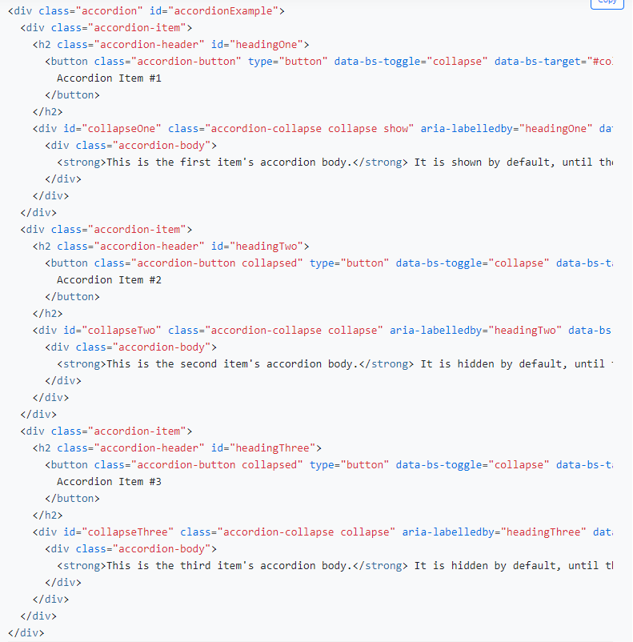
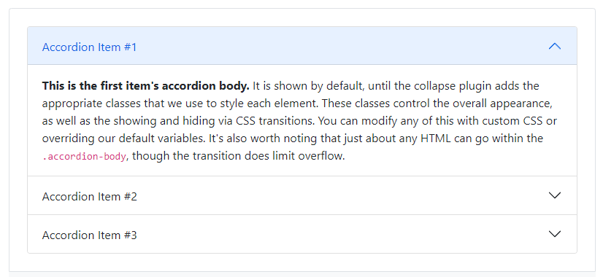
| Components |
Many more reusable components built to provide iconography, dropdowns, input groups, navigation, alerts, and much more.
Accordion

Slide 7
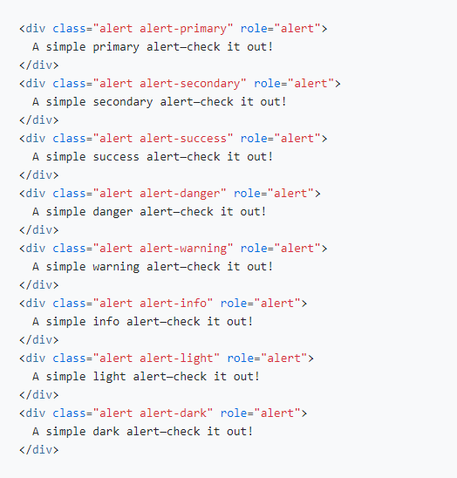
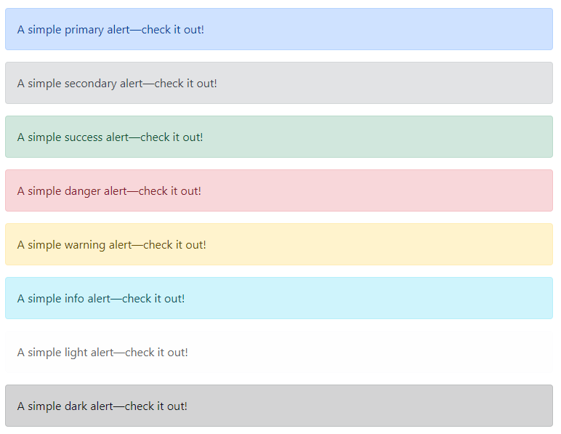
| Components |
Alerts

Slide 8
| Components |
Accordion
Alerts
Badge
Breadcrumb
Buttons
Button group
Card
Carousel
Close button
Collapse
Dropdowns
List group
Modal
Navs & tabs
Navbar
Offcanvas
Pagination
Popovers
Progress
Scrollspy
Spinners
Toasts
Tooltips

Slide 9
| Advantages of Bootstrap |
Fewer Cross browser bugs
A consistent framework that supports major of all browsers and CSS compatibility fixes
Lightweight and customizable
Responsive structures and styles
Several JavaScript plugins using the jQuery
Good documentation and community support
Loads of free and professional templates, WordPress themes and plugins
Great grid system

Slide 10
THANK YOU!

